Slide 1
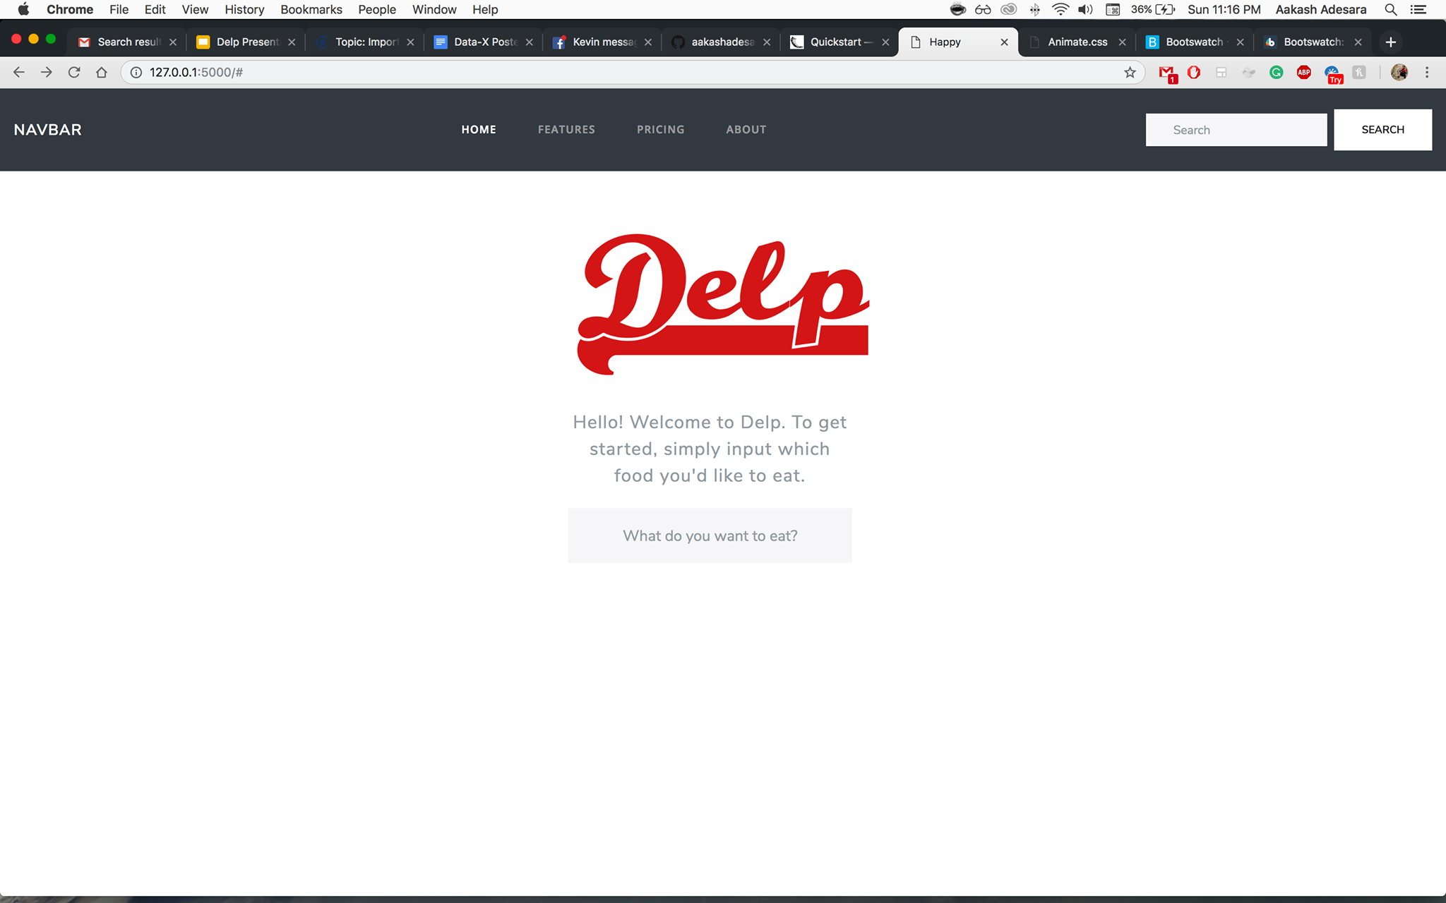


Delp
NLP powered Food Recommender to help you pick the best dish from the best restaurant using big data.
Aakash Adesara, Alan Liang, John Ly, Kevin Ko, Mihir Thummar

Slide 2

User Story (Case 1) The story of a SF traveler
Jaxon is at a new restaurant in San Francisco
While in line, he doesn’t know what to get: what’s good?
He goes to Yelp and is forced to read many reviews to synthesize what is good and bad.
How inconvenient!
He wishes the Yelp would just recommend the best food at this restaurant.

Slide 3
Introduction to Delp
Collects data on restaurants and yelp reviews to determine the best items to get using sentiment analysis
User can search for specific food items and get instant restaurant recommendations based on others’ reviews and ratings
Saves the user time so they can quickly decide what to try instead of having to manually read through all the reviews
Enjoy (hopefully) good food from popular opinions (BIG data)

Slide 4
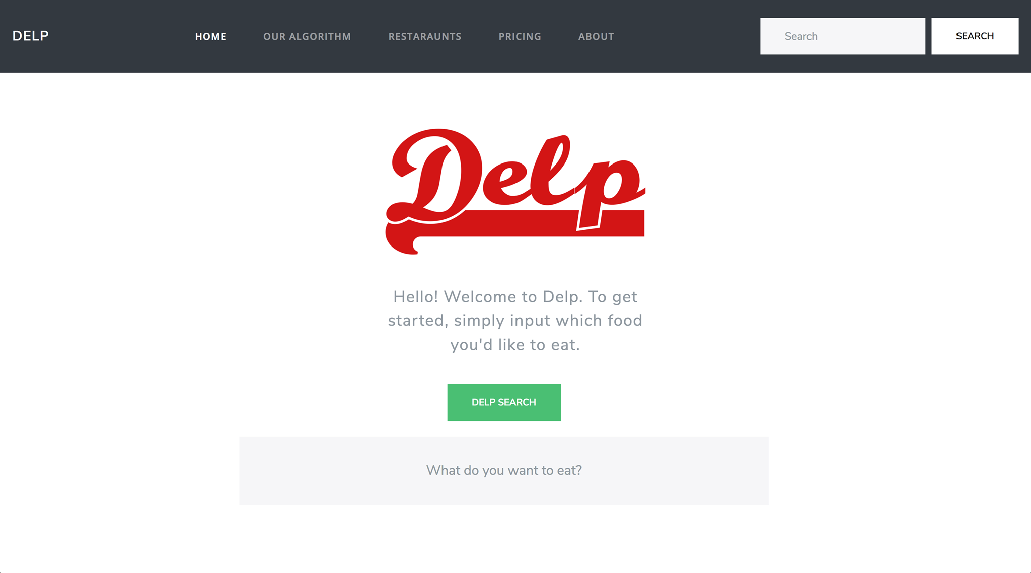

Slide 5
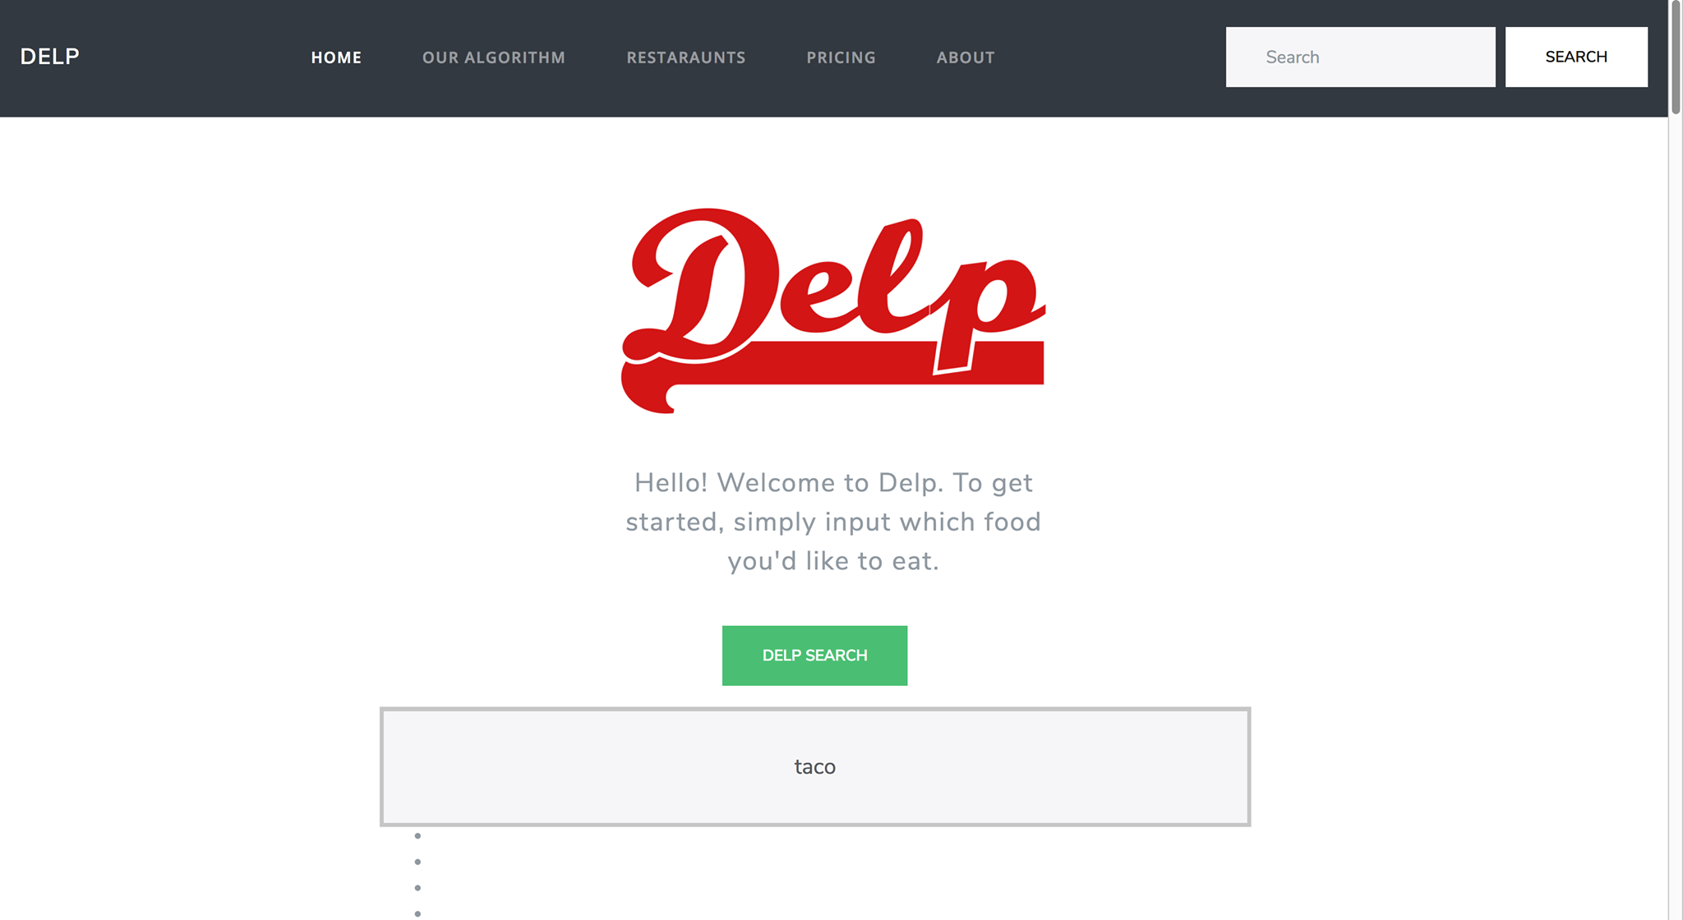

Slide 6
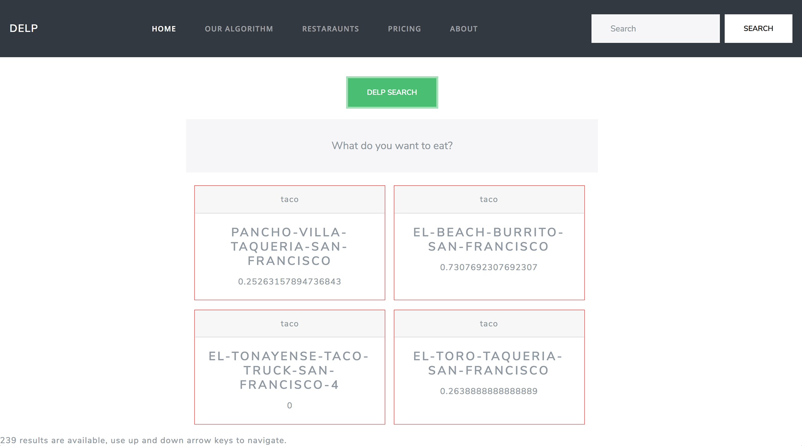

Slide 7
Live Demo

Slide 8
Q&A

Slide 9
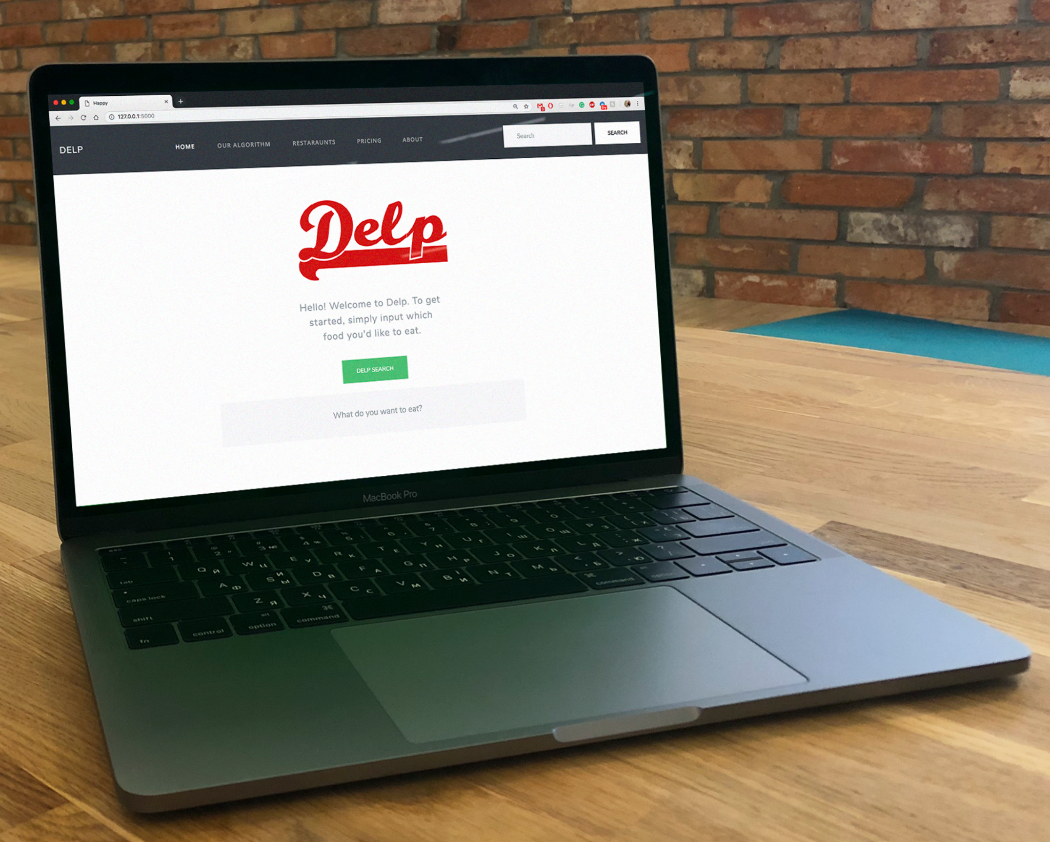
Try it yourself!
Github Repo: https://github.com/johnly98/Delp

Slide 10
Thank You
Github Repo: https://github.com/johnly98/Delp

